Slide 1

Object Oriented Programming
Operator Overloading

Slide 2
Function Overloading
Function overloading is a feature in C++ that allows multiple functions to have the same name but different parameter lists.

Slide 3
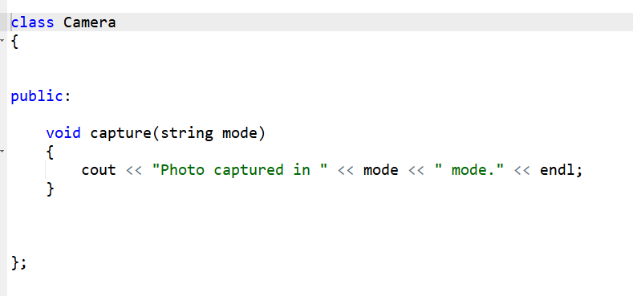
Demonstration

Slide 4
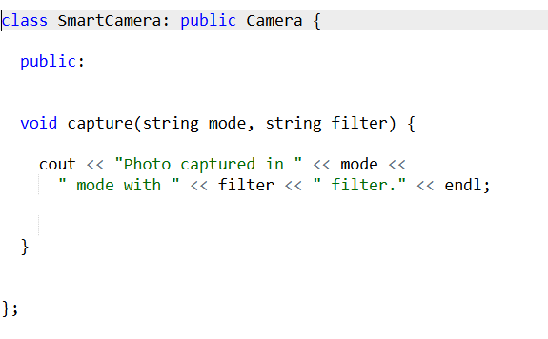
Demonstration

Slide 5
Demonstration
int main()
{
SmartCamera smCamera;
smCamera.capture("Portrait", "B & W");
return 0;
}

Slide 6
Demonstration
When a child class defines a function with the same name, it hides all parent functions with that name.
int main()
{
SmartCamera smCamera;
smCamera.capture("Portrait");
return 0;
}

Slide 7
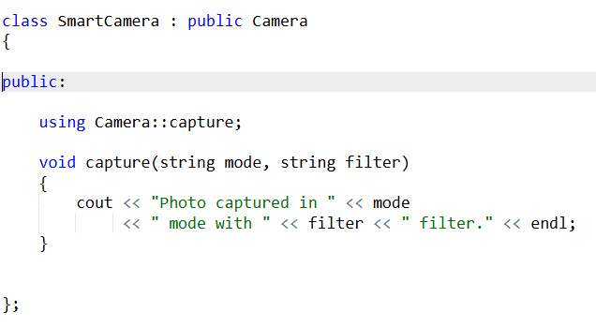
Demonstration
It tells the compiler that the parent class version of capture() should also be visible inside the child class
int main() { SmartCamera smCamera; smCamera.capture("Normal"); smCamera.capture("Portrait", "B & W"); return 0; }

Slide 8
Inheritance Access Specifiers
Inheritance Type | Public Members Become | Accessible Outside Object?
public | public | Yes
private | private | No
protected | protected | No

Slide 9
Demonstration
class Camera
{
public:
void capture() { }
};
class SmartCamera : public Camera
{
};
int main()
{
SmartCamera s;
s.capture(); // allowed
}
class Camera
{
public:
void capture() { }
};
class SmartCamera : private Camera
{
};
int main()
{
SmartCamera s;
s.capture(); // not allowed
}

Slide 10


THANK YOU!

